Slide 1

Retrofitted PLC Digital Forensics: A Methodical Approach with Data Artifact Taxonomy and External Libraries
Young Park,
Zejun Li,
&
Sheikh Md Mushfiqur Rahman
Boise State University

Slide 2
Outline of The Presentation
Introduction
Literature review
Methodology
Case study
Discussion, Limitation and Future Work
Conclusion

Slide 3
Introduction
A lack of research and resources specific to PLC digital forensics exists.
The research aims to identify the potential of third-party libraries for PLC digital forensics investigation with the help of existing data artifact taxonomy.
A case study that demonstrates an attack scenario on a Siemens PLC (SIMATIC S7-1500) is presented.
In short, a method has been proposed to make digital forensic investigation on PLC more accessible and optimized.

Slide 4
Objectives
Conduct a digital forensic investigation on a PLC using using an existing taxonomy of PLC data artifacts.
Utilize third party tools to conduct digital forensic investigation on PLC.
Identify and refine gaps in the taxonomy.
In short, create a streamlined process to make PLCs forensic investigation accessible without technical expertise. (for example wix for web application development or TensorFlow Lite for machine learning)

Slide 5
Motivation
Understand PLC data artifacts in diverse industries.
Address the need for forensic readiness in heterogeneous infrastructure.
Analyze and contrast PLC vendor taxonomies and data artifacts.
Empower forensic experts, security professionals, and infrastructure managers.
Enhance critical infrastructure security and resilience.

Slide 6
Related Work
Shahbi et al. (2023) highlighted the necessity for a thorough taxonomy that will help with the forensic examination of PLC data artifacts. The study emphasizes how essential it is to comprehend PLCs' special traits and how they fit into industrial control systems.
Cook et al. (2020) introduced a taxonomy for forensics data types that can be obtained from PLCs. The taxonomy offers an organized method for collecting and analyzing digital evidence from PLCs, acting as a guide for investigators.

Slide 7
Related Work
Azfar et al. (2016) conducted a taxonomy on the data acquisition from different android application and what type of data those applications can collect. The idea behind the study is to enable forensic practitioners to acquire data from these applications quickly during investigation.
Mishra et al. (2018) offered a thorough taxonomy of forensic instruments made specifically for obtaining data from cloud endpoints. In order to help forensic investigators find tools that meet their technical needs during cloud forensic investigations, the taxonomy provides a searchable catalog.

Slide 8
Related Work
Ahmed et al. (2017) highlighted the challenges of PLC forensics, particularly given the lack of system logging. They suggest a unique methodology that combines machine learning techniques with logging pertinent memory addresses utilized by a PLC programs to detect unusual operations.

Slide 9
Methodology
Create a matrix that lists the data artifacts relevant to PLC digital forensics.
Create an attack scenario and start data acquisition of the PLC based on the taxonomy.
Extract the data artifacts using third party libraries and analyze them for each vendor and fill in the corresponding cells in the matrix.
Identify gaps in the taxonomy and refine them based on the comparison findings.
Streamline the investigation process on PLCs.

Slide 10
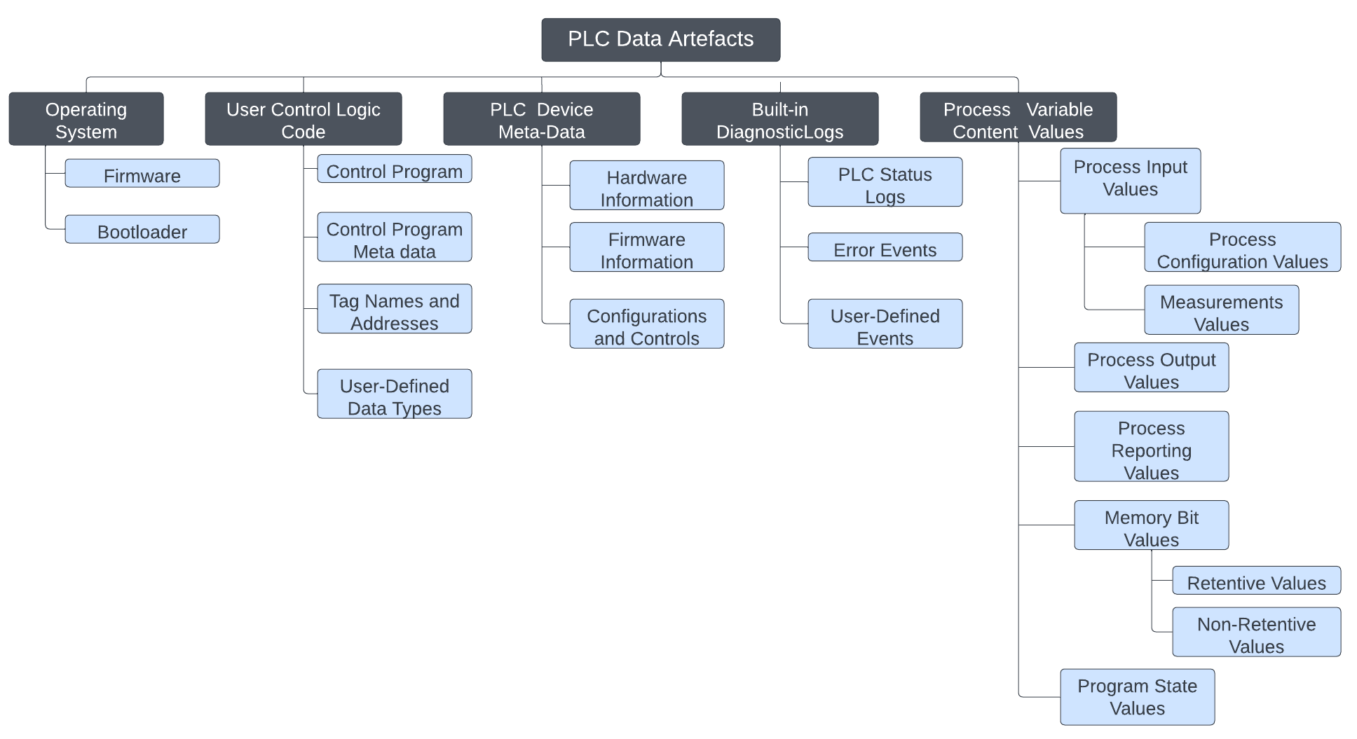
Methodology: The existing taxonomy

Slide 11
Methodology: The matrix based approach
PLC Data Types and Artefacts | Description | Emulator S7-1500 PLC
Operating System
Firmware | … | …
Bootloader | … | …
PLC Data Types and Artefacts | Description | PLCs Acquired From
User Control Logic Code
Control Program | … | …
Control Program Meta data | … | …
Tag Names and Addresses | … | …
User-Deﬁned Data Types | … | …
PLC Data Types and Artefacts | Description | PLCs Acquired From
PLC Device Meta-Data
Hardware Information | … | …
Firmware Information | … | …
Tag Names and Addresses | … | …
Conﬁgurations and Controls | … | …

Slide 12
Methodology
Fill in the corresponding cells for S7-1500 PLC. This involves collecting data on the data artifacts from S7-1500 PLC and entering the information into the matrix.
Analyze the matrix to identify vendor-specific idiosyncrasies in digital artifacts.
Refine the taxonomy based on the comparison findings.

Slide 13
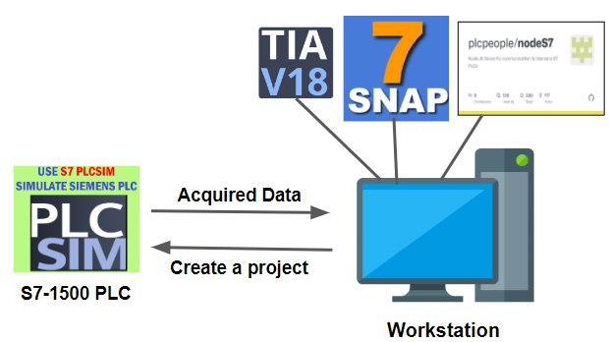
Methodology
Workflow:
Set up a workstation with Siemens (SIMATIC S7-1500) PLC programming environments.
Create and download a simple ladder logic program to PLCs.
Allow program to run on PLC to generate data.
Use libraries and S7commPlus protocol to acquire data from PLCs.

Slide 14
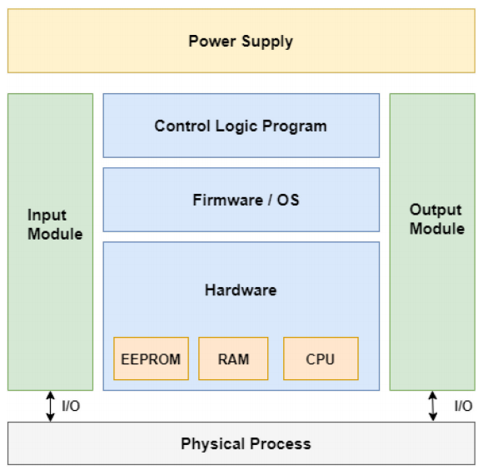
Case Study: S7-1500 PLC Architecture
The standard architecture of an S7-1500 PLC, consists of essential components such as input and output modules, a power supply, and various forms of memory including Random Access Memory (RAM) and Electrically Erasable Programmable Read-only Memory (EEPROM). The firmware or Operating System (OS) of the PLC, along with user-specific programs, is stored in the EEPROM.

Slide 15
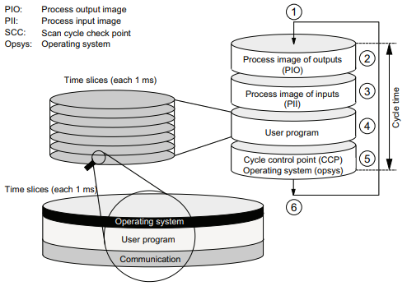
Case Study: S7-1500 PLC cyclic program processing
Siemens PLCs are equipped with a real-time operating system (OS) that initiates cycle time monitoring. This operating cycle involves four key steps executed by the CPU.
The CPU transfers the values from the process image of the outputs to the output modules.
The second step involves the CPU reading the status of the input modules. After reading, it updates the process image with the input values.
In the third step, the user program is run in specific time slices,each lasting 1 millisecond (ms). These time slices are further divided into three distinct parts, which are executed one after the other: the operating system, the user program, and communication tasks.

Slide 16
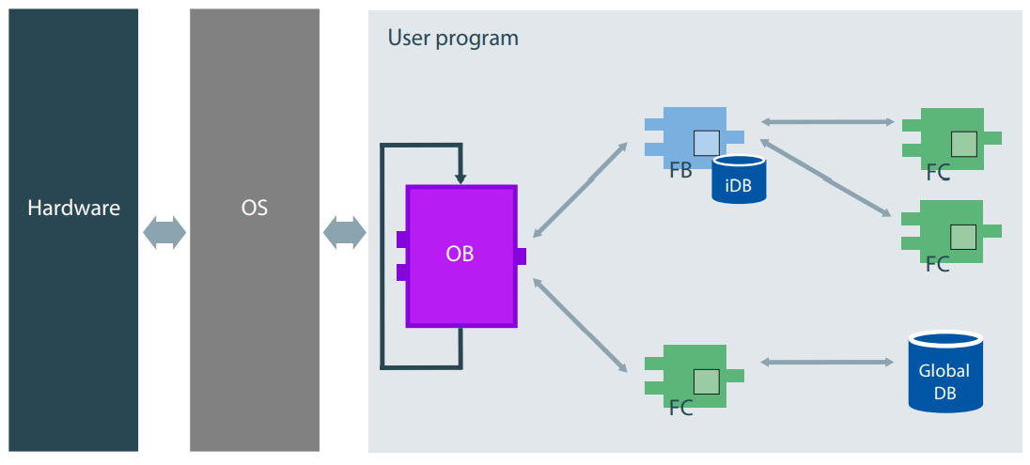
Case Study: S7-1500 PLC’s controller programming
User Programs designed for Siemens S7 PLCs are structured into various units, including Organization Blocks (OBs), Functions (FCs), Function Blocks (FBs), Data Blocks (DBs), System Functions (SFCs), System Function Blocks (SFBs), and System Data Blocks (SDBs).

Slide 17

Case Study: S7-1500 PLC’s Testbed Setup(Snap7)

Slide 18
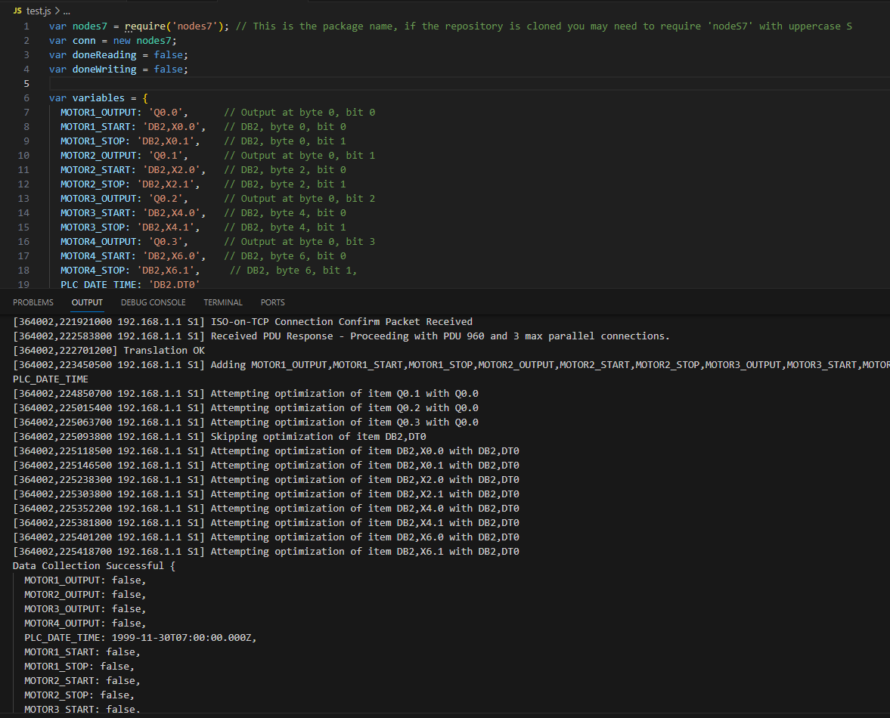
Case Study: S7-1500 PLC’s Testbed Setup(Nodes7)
Ideal for acquiring real-time operational data from the PLC, such as current values of tags, status of various inputs/outputs.

Slide 19
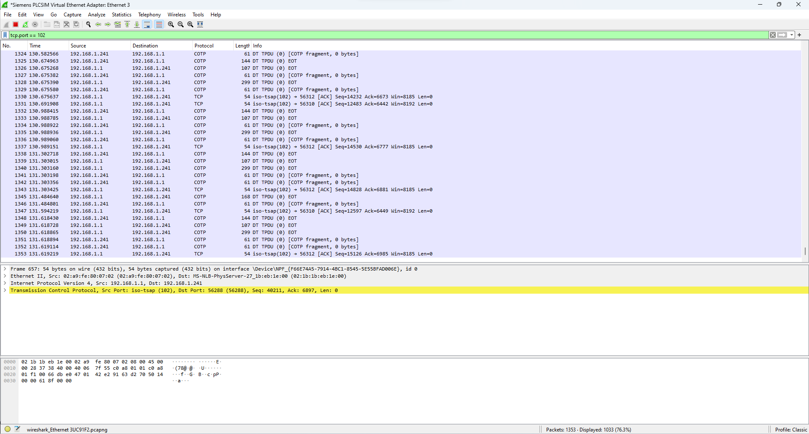
Case Study: S7-1500 PLC’s Testbed Setup(S7commPlus)
OSI layer | Protocol
7. Application layer | S7Comm-Plus
6. Presentation Layer | COTP
5. Session Layer | TPKT
4. Transport Layer | ISO-on-TCP (RFC 1006)
3. Network Layer | IP
2. Data Link Layer | Ethernet
1. Physical Layer | Ethernet

Slide 20
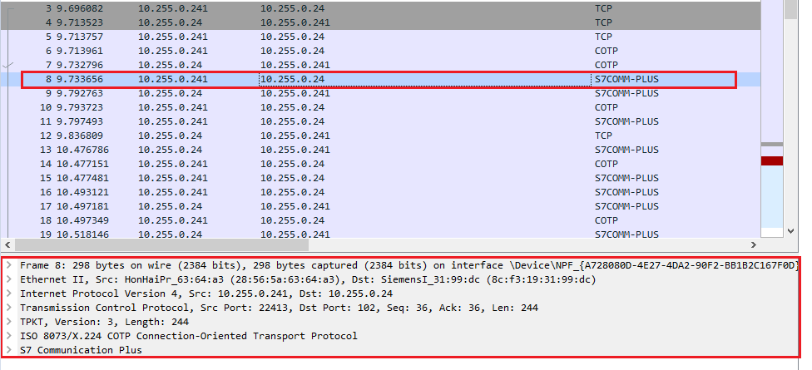
Case Study: S7-1500 PLC’s Testbed Setup(S7commPlus)
Ex. Using the physical s7 PLC

Slide 21
Case Study: Matrix Creation
PLC Data Types and Artefacts | Acquired from S7-1500 PLC Emulator
Operating System
Firmware | No
Bootloader | No
PLC Data Types and Artefacts | Acquired from S7-1500 PLC Emulator
User Control Logic Code
Control Program | No
Control Program Meta data | No
Tag Names and Addresses | No
User-Deﬁned Data Types | No
PLC Data Types and Artefacts | Acquired from S7-1500 PLC Emulator
PLC Device Meta-Data
Hardware Information | Yes
Firmware Information | No
Tag Names and Addresses | Yes
Conﬁgurations and Controls | Yes
PLC Data Types and Artefacts | Acquired from S7-1500 PLC Emulator
Built-In Diagnostic Logs
PLC Status Logs | No
Error Events | No
PLC Data Types and Artefacts | Acquired from S7-1500 PLC Emulator
Process Variable Content Values
Process Input Values | Yes
Process Output Values | Yes
Process Reporting Values | Yes
Memory Bit Values | Yes
Program State Values | Yes

Slide 22
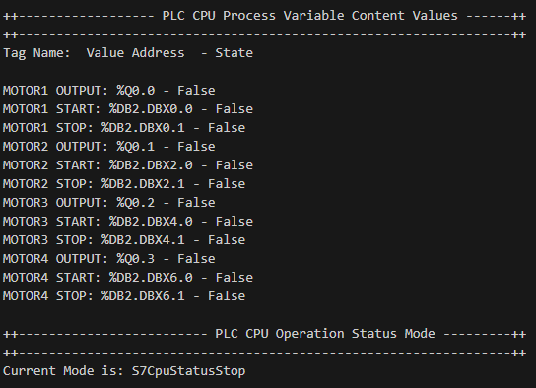
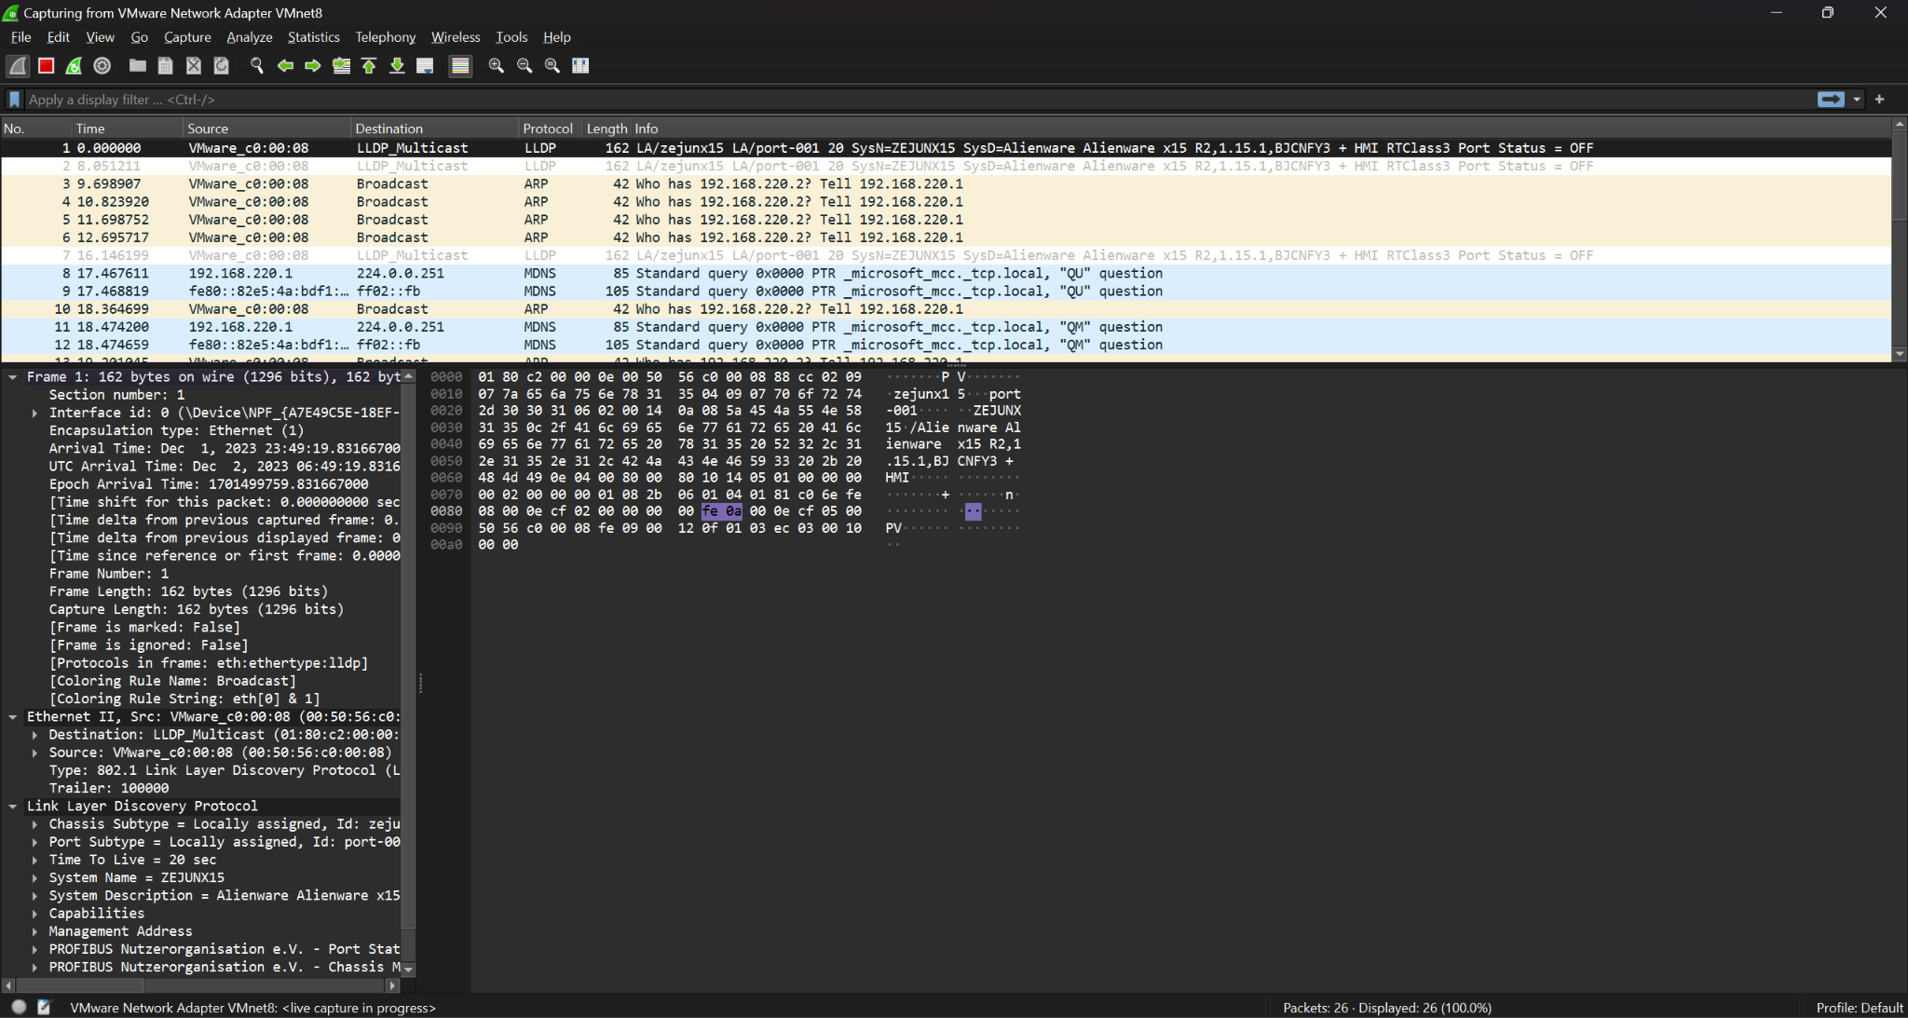
Attacking Scenario
Attacker:
Change IP-Address to 192.168.1.5
Change Operation Mode to Stop
Change Watch Table Values
Investigator:
Use Wireshark to capture activity
Use Snap7 to collect data

Slide 23
Discussion, Limitation and Future Work
Discussion:
Our research delves into the identification and definition of data artifacts retrievable from the Siemens S7-1500 PLC, particularly in the context of digital forensics.
Our study stands out by providing a more detailed and specific taxonomy of PLC data types, a step beyond what current research offers.
Limitations:
Simulated PLCs have restrictions on certain functions, limiting the scope compared to physical PLCs.
Attack scenario is too simple based on the limitation of simulated PLC
Case study conducted on a single PLC, limiting the generalizability of the findings.
Future Work:
Extend the digital forensics method to different PLCs, including Rockwell Allen-Bradley ControlLogix 1756-L71/B and Siemens S7-300.
Utilize more standardized codebases and third-party libraries for a broader and more comprehensive investigation.
Aim to simplify digital forensics investigations of PLCs by incorporating third-party tools, making it accessible to individuals without technical expertise.

Slide 24
Conclusion
Tools for digital forensics: NodeS7, Snap7, Wireshark
Tools for creating Simulated Siemens S7 1500: TIA Portal, PLCSIM Advanced
Certain data artifacts are not supported to collect due to the restriction of Simulated PLC
Attack Scenario can be improved for physical PLC
Taxonomy can be improved
Extend digital forensics methods to more different PLC

Slide 25
Q/A
Thank you!

